Slide 1
Introduction to Python
Notes:
1

Slide 2
Introduction to Python
Basics
Importance of python for machine learning
IDE (jupyter)
Basic functionality + Hello word
Notes:
1

Slide 3
Introduction to Python
Data types
Numbers
Strings
Lists
Dictionaries
Tuples
Sets
Notes:
1

Slide 4
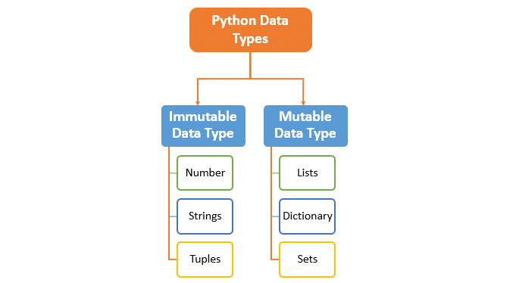
Introduction to Python
Data Types
Notes:
1

Slide 5

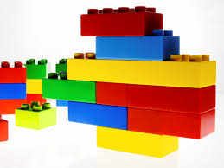
Introduction to Python
Immutable
Mutable
Immutable cannot be changed after it is created
Mutable can be changed after it is created
Notes:
1

Slide 6
Introduction to Python
Numbers
Python supports integers, floating point numbers
Numbers are used for arithmetic operations, storing information etc
x = 5 # int
x = 5.0 # float
The best thing about python is that you don't have to define the datatype of a variable
Notes:
1

Slide 7
Introduction to Python
Strings
String is a sequence of characters
It is used to represent text instead of numbers
String in python can be easily concatenated, sliced, etc
str = 'Hello World' # string declaration
print(str) # outputs Hello World
print(str + ' ' + str) # outputs Hello World Hello World
print(str[0:5]) # outputs Hello
Notes:
1

Slide 8
Introduction to Python
Tuples
A tuple is an immutable python object which means it cannot be changed once it's created.
Tuples are like an array but each element in a tuple can be of different types
Declaration symbol ( )
my_tuple = (30, 45.6 , 'hello') #This tuple consists of an integer, float, and string
Notes:
1

Slide 9
Introduction to Python
Lists
Unlike tuple, lists are mutable which means that lists can be changed after creation, otherwise
their behavior is same as a tuple
Declaration symbol [ ]
my_list = [30, 45.6 , 'hello'] # This list consists of an integer(30), float(45.6), and string(“hello”)
My_list[0] = ‘hello’
Please notice that I have changed the type and value of an element in a list if we tried to do something like this in tuple, this will be considered as error
Notes:
1

Slide 10
Introduction to Python
Dictionaries
A dictionary is a collection which is unordered, changeable and indexed.
In Python, dictionaries are written with curly brackets, and they have keys and values.
Dictionary holds key:value pair.
Key value is provided in the dictionary to make it more optimized
Declaration symbol {key:value}
My_dict = { 'id': 1, 'name': 'John', 'age': 32 } # the id, name and john are keys
# while 1, john and 32 are values
My_dict['id'] # outputs 1
My_dict['name'] # outputs john
My_dict['age'] # outputs 32
Notes:
1

Slide 11
Introduction to Python
Sets
Set is an unordered collection of data types that is iterable and mutable.
Sets in python are similar to sets in mathematics.
The value in sets cannot be repeated and a set cannot be indexed.
A set is normally used to verify if a specific element exists in a set or not.
Declaration symbol { }
my_set = {1,2,3,4,5,5,6,6} # outputs {1,2,3,4,5,6}
my_set.add(7) # adds 7 to the set
my_set.remove(2) # removes 2 from set
my_set.union(other_set) # takes union with other_set
my_set.intersection(other_set) # takes intersection with other_set
Notes:
1

Slide 12
Introduction to Python
Operators
Comparison Operators
Logical Operators
Notes:
1

Slide 13
Introduction to Python
Comparison Operators
Equal == value == 5
Not equal != value != 5
Greater than > value > 5
Less than < value < 5
Greater than or equal to >= value >= 5
Less than or equal to <= value <= 5
Notes:
1

Slide 14
Introduction to Python
Logical Operators
and
or
Not (!)
Notes:
1

Slide 15
Introduction to Python
and
(true) and (true) returns true
(true) and (false) returns false
(false) and (true) returns false
(false) and (false) returns false
Notes:
1

Slide 16
Introduction to Python
or
(true) or (true) returns true
(true) or (false) returns true
(false) or (true) returns true
(false) or (false) returns false
Notes:
1

Slide 17
Introduction to Python
Not (!)
!(true) returns false
!(false) returns true
0, empty string or null is considered false
Any other number or string is considered true
Notes:
1

Slide 18

Introduction to Python
Decision Making
If, elif, else
Nested decision making
Notes:
1

Slide 19
Introduction to Python
if
If weather = “sunny”
then
“I will play outside”
Notes:
1

Slide 20
Introduction to Python
elif
If weather = “sunny”
then
“I will play outside”
else if weather = “rainy”
then
“I will play video games”
Notes:
1

Slide 21
Introduction to Python
else
If day = “sunday”
then
“I will go to the amusement park”
else
“I will stay at home”
Notes:
1

Slide 22
Introduction to Python
Nested If
if weather = “sunny”
then
“Call friends”
if friends = “available”
then
“I will play soccer”
Notes:
1

Slide 23

Introduction to Python
Loops
For loops
While loop
Notes:
1

Slide 24
Introduction to Python
For loops
For loop is used for iterating over a sequence that is either a list, a tuple,
a dictionary, a set, or a string.
Syntax:
for index in range(len(sequence)): or for iterator in sequence:
for i in range(len(my_list)): #range function return the range of elements in a sequence
print(my_list[i])
for i in my_list: # i becomes the element of list itself and will iterate through all
print(i) # elements of sequence(my_list)
Notes:
1

Slide 25


Introduction to Python
Functions
A function is a block of code which only runs when it is called. You can pass data, known as parameters, into a function.
SRP(Single Responsibility Principle)
Type:
Simple functions
Boolean functions
Value returning functions
Notes:
1

Slide 26
Introduction to Python
Simple functions
A simple function is a block of code that performs a specific operation
def my_first_function:
print(“This is my first function”)
def my_first_function(data):
print(data)
data = “this is my first parameterized function”
my_first_function(data)
Notes:
1

Slide 27
Introduction to Python
While loop
While loop is a conditional loop which means it will run until the given condition is fulfilled
A variable is normally used in the condition which is updated in every iteration
value = 0
while(value<5):
print(value)
value+=1
Notes:
1

Slide 28
Introduction to Python
Boolean functions
A function is a block of code which only returns true or false
def my_boolean_function:
return true
def is_less(x,y):
return x < y ? true : false
x = 2
y = 6
if my_boolean_function(x , y):
print(“x is less than y”)
Notes:
1

Slide 29
Introduction to Python
Value returning functions
A value returning function is a block of code which returns one or more values
def my_function:
return ‘I am a value returning function’
def get_minimum(x,y):
return x < y ? x : y
x = 2
y = 6
answer = get_minimum(x , y)
Notes:
<number>

Slide 30
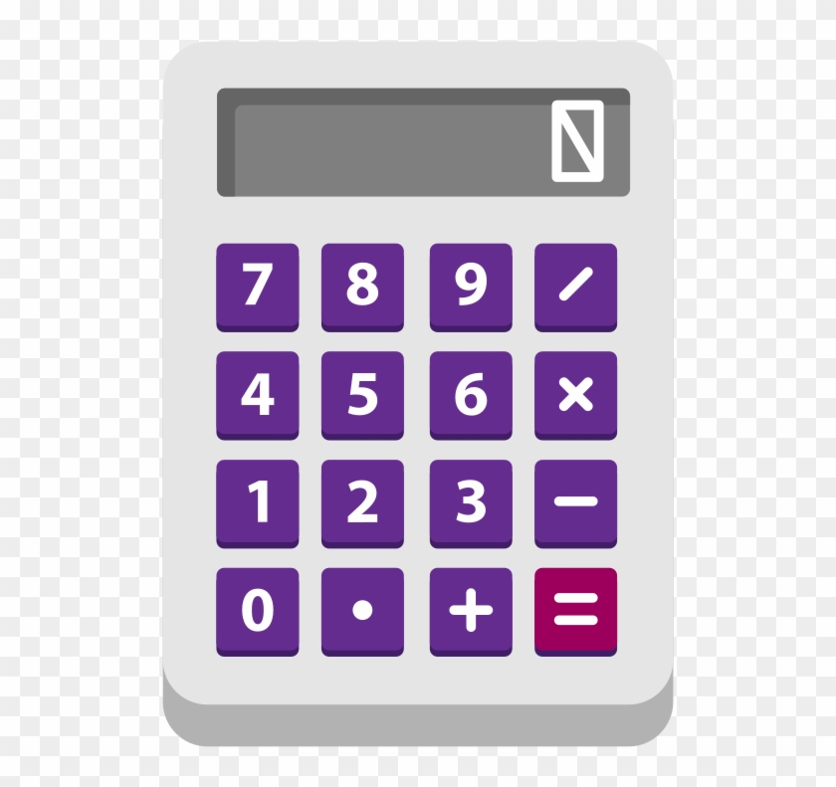
Introduction to Python
Functions
Project (Calculator)
Notes:
<number>

